Slide 1
AI PROJECT
CUSTOMER DATA MANAGEMENT APPLICATION
Balogh Ádám – Dunai Krisztán

Slide 2
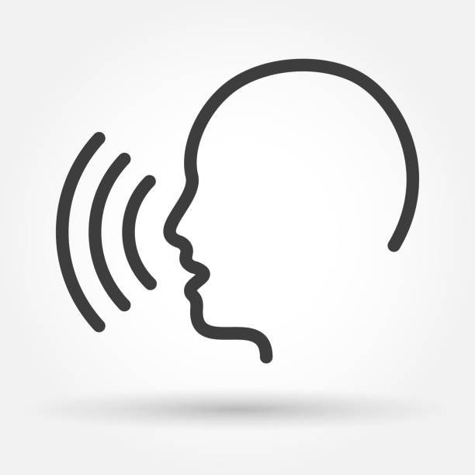


COMMUNICATION TOOLS
VOICE 🗣️🔥 🗣️🔥 🗣️🔥 🗣️🔥 🗣️🔥
MESSENGER

Slide 3
USED TOOLS
01
03
02
04
GITHUB
FIGMA
VISUAL STUDIO
CHATGPT

Slide 4

FIGMA - WIREFRAME

Slide 5
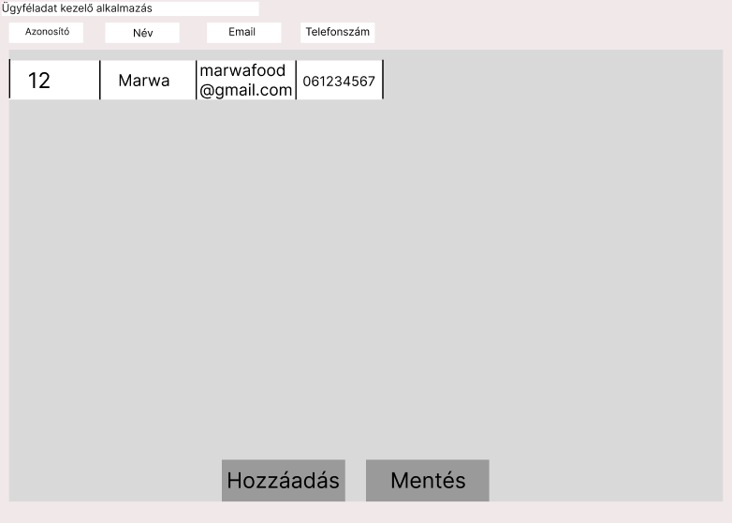
FIGMA - PROTOTYPE

Slide 6
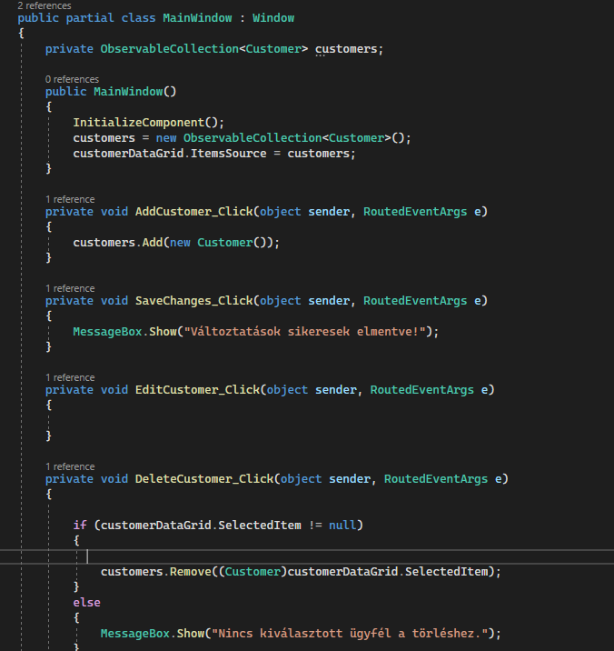
CODE – C#

Slide 7
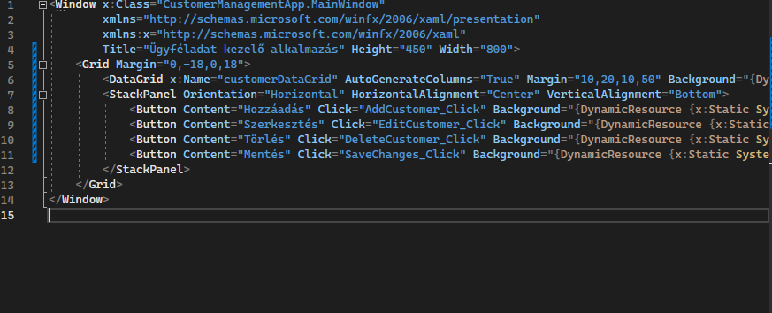
CODE - XAML

Slide 8
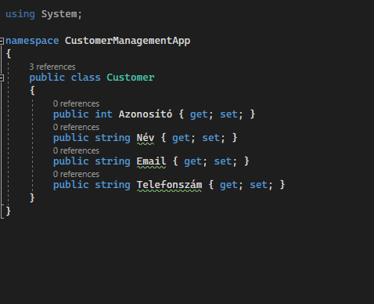
CODE - CLASS

Slide 9
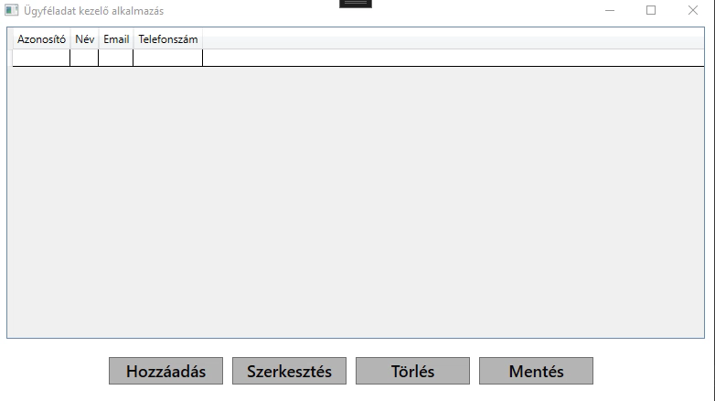
—SOMEONE FAMOUS
“This is a qute, words full of wisdom that someone iportant said and can make the reader get inspired.”

Slide 10
THANKS FOR WATCHING!
Balogh Ádám – Dunai Krisztián

